Slide 1
NLP PROJECT REPORT
Project Title:-
Ajio Review Summarizer
Guided by
Dr. Sourav Kumar Dandapat
Submitted by (M.Tech AI)
Shivank Gupta 2411AI08
Aditya Tiadi 2411AI34
Anubhav Kant 2411AI10

Slide 2
Problem Definition :-
In a diverse market like India, consumers rely heavily on product reviews to determine the usefulness of a product before purchasing. However, not all products that perform well globally are necessarily useful in India due to regional preferences, climate, infrastructure, or cultural factors.
This project aims to determine whether a product is useful in India based on user reviews. It involves:
Dataset Collection – Gathering 50 products with 500 reviews each from Indian users and annotating their usefulness.
Analysis – Performing sentiment analysis and aspect-based opinion mining to understand user preferences.
Prediction Model – Using these insights to train a classification model that predicts whether future products will be useful in India.

Slide 3
Task 1: Dataset Collection
Goal: Collect reviews for 50 Ajio products (500 reviews each) from Indian users and annotate whether a product is useful in India.

Slide 4
Steps : How to collect data
1. Web scraping :
There are tools like BeautifulSoup, Selenium, or Scrapy to scrape the data.
Target URLs for 50 Ajio product pages.
Extract the features like
Product Name
Review ID
User Name
Review Text
Rating
Is UsefuI in India
2. Save to CSV :
After collecting the data save it as a CSV file.
Columns: Product_Name, Review_ID, User_Name, Review_Text, Rating, Is_Useful_In_India

Slide 5
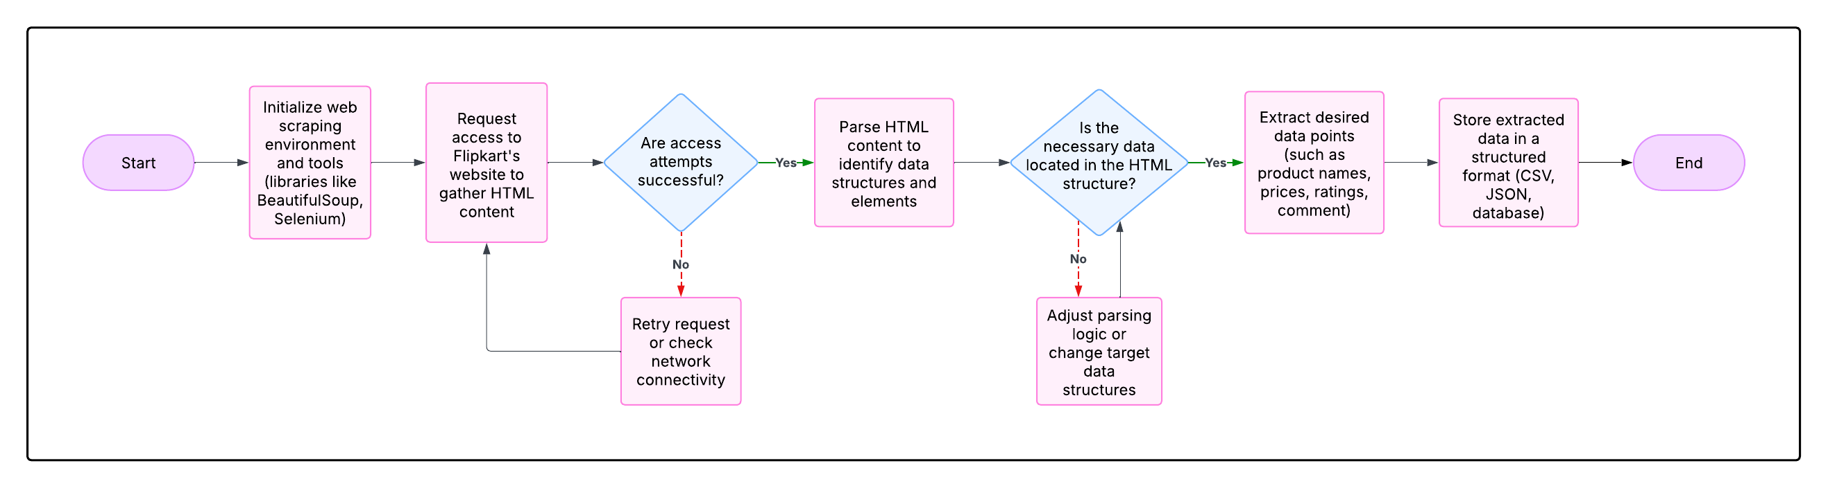
Flow Chart of Web Scraping

Slide 6
Task 2 : Preprocessing
To ensure high-quality and consistent data for sentiment analysis, we have to do the following preprocessing steps :
Handling Missing Data by dropping the missing values in critical features.
Text Normalization can be done by converting the sentences to lowercase.
Noise Removal : Special characters, numbers, and punctuation marks were removed from the review text using regular expressions.
Tokenization : Each review was split into individual words (tokens), making it easier to analyze and process the text at the word level.
Stopword Removal : Common English stopwords (such as "the", "is", "and", etc.) were removed.
Lemmatization : Words were reduced to their base.

Slide 7
Task 3 : Sentiment Analysis using VADER
We apply VADER (Valence Aware Dictionary and sentiment Reasoner) which is a rule-based sentiment analysis tool, specifically designed to analyze text from social media and user reviews. It uses a pre-defined lexicon of words labeled with sentiment intensity scores.
In this project, VADER was applied to each review to compute sentiment scores, which includes Positive, negative and neutral.
Compound score is being calculated (a normalized score between -1 and +1 indicating overall sentiment)
Based on the compound score calculated using polarity score:
- Reviews with a score ≥ 0.05 were labeled Positive
- Reviews with a score ≤ -0.05 were labeled Negative
- Scores in between were considered Neutral
VADER was chosen due to its effectiveness in handling short texts like product reviews

Slide 8
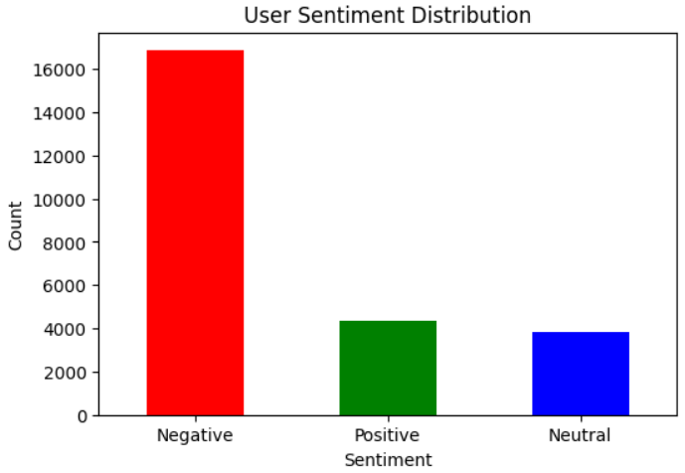

Slide 9
Task 4 : Aspect Based opinion Mining
Aspect-Based Opinion Mining (ABOM) is used to identify specific features or components of a product that users have expressed opinions about. In this project, noun phrases such as “fit”, “material”, “delivery”, and “color” were extracted from each review as product aspects.
Using sentiment analysis tools, the sentiment associated with each aspect was determined by analyzing nearby opinion words. Each aspect was then labeled as positive, negative, or neutral.
This method enabled a more fine-grained understanding of user opinions, highlighting which parts of the product were appreciated (e.g., “fit is perfect”) and which were criticized (e.g., “material feels cheap”).

Slide 10
Task 4.1 : How to do Aspect Based opinion Mining
1. Iterates through each review, 2. Extracts the aspects mentioned in the review (from the "Aspects" column), 3. Calculates the sentiment polarity of the full review using TextBlob (ranges from -1 = very negative to +1 = very positive), 4. Maps each aspect in that review to the overall review's sentiment score, 5. Aggregates and averages these sentiment scores for each aspect (only if the aspect appears more than 5 times), 6. Finally, it displays: 6.1 The top 10 appreciated aspects (i.e., those with the highest average sentiment), 6.2 The top 10 criticized aspects (i.e., those with the lowest average sentiment).

Slide 11
Task 5 : Output
Sentiment Distribution For each product, the proportion of positive, negative, and neutral reviews was calculated. These were visualized using graphs, offering a quick view of the general sentiment trend.
Aspect Sentiment Analysis Common product aspects such as “fit”, “material”, and “delivery” were analyzed for sentiment. A summary table was generated to show which aspects were appreciated and which were criticized.
Word Clouds Separate word clouds for positive and negative reviews were created to highlight frequently mentioned terms and provide an intuitive understanding of the user's vocabulary.
Product Usefulness Label Based on the overall sentiment and aspect-based opinions, each product was tagged as either “Useful in India” or “Not Useful”, helping draw actionable insights.

Slide 12
Task 6 :Classification Model for Predicting Product Usefulness
To predict whether future products will be useful in India, a machine learning classification model was developed using features derived from the earlier sentiment and opinion mining analysis.
Feature Engineering : following features were used to train the model
Average sentiment score across reviews
Percentage of positive and negative reviews
Sentiment scores associated with key aspects
Model Training and Evaluation : for this we can use these algorithms
Logistic Regression
Random Forest
Support Vector Machine (SVM)
The dataset was split into training and testing sets, and models were evaluated based on accuracy, F1-score, and confusion matrix. The best-performing model was selected to predict the usefulness of future products based on the input features.

Slide 13
Task 6.1 :Classification Model Using Random Forest
To predict whether a product will be useful in India, we trained a Random Forest Classifier using the extracted features from sentiment analysis and aspect-based opinion mining.
Steps Followed
Dataset Splitting : The dataset was split into training and testing sets using an 80:20 ratio with train_test_split. This ensures the model is evaluated on unseen data.
Model Training : A Random Forest Classifier was used, which is an ensemble learning method combining multiple decision trees for better accuracy and robustness. We used 100 trees (n_estimators=100) and fixed a random seed for reproducibility.
Prediction and Evaluation
Accuracy Score – Overall correctness of predictions.
Classification Report – Includes precision, recall, and F1-score for each class

Slide 14
Task 7 : Sentiment Analysis using LSTM
Steps :
Step 1: Install Required Libraries
Step 2: Load and Explore the Dataset
Step 3: Create Sentiment Labels from Rating
Step 4: Preprocess the Review Text
Step 5: Tokenization and Padding
Step 6: Split Data into Train and Test Sets
Step 7: Build the LSTM Model
Step 8: Train the Model
Step 9: Evaluate the Model
Step 10: Predict Sentiment on New Reviews
Step 11: Save the Model for Future Use
Step 12: Load and Use the Model Later

Slide 15
Conclusion
For sentiment analysis, we experimented with both VADER (a lexicon-based approach) and an LSTM-based deep learning model. While VADER performs well on short, general-purpose reviews with basic sentiment, it lacks the ability to understand contextual nuances.
In the LSTM model, trained on our specific dataset, demonstrated higher accuracy by effectively capturing context, grammar, and emotional tone within reviews. Hence, LSTM proved to be a more accurate approach for sentiment analysis in our task.

Slide 16
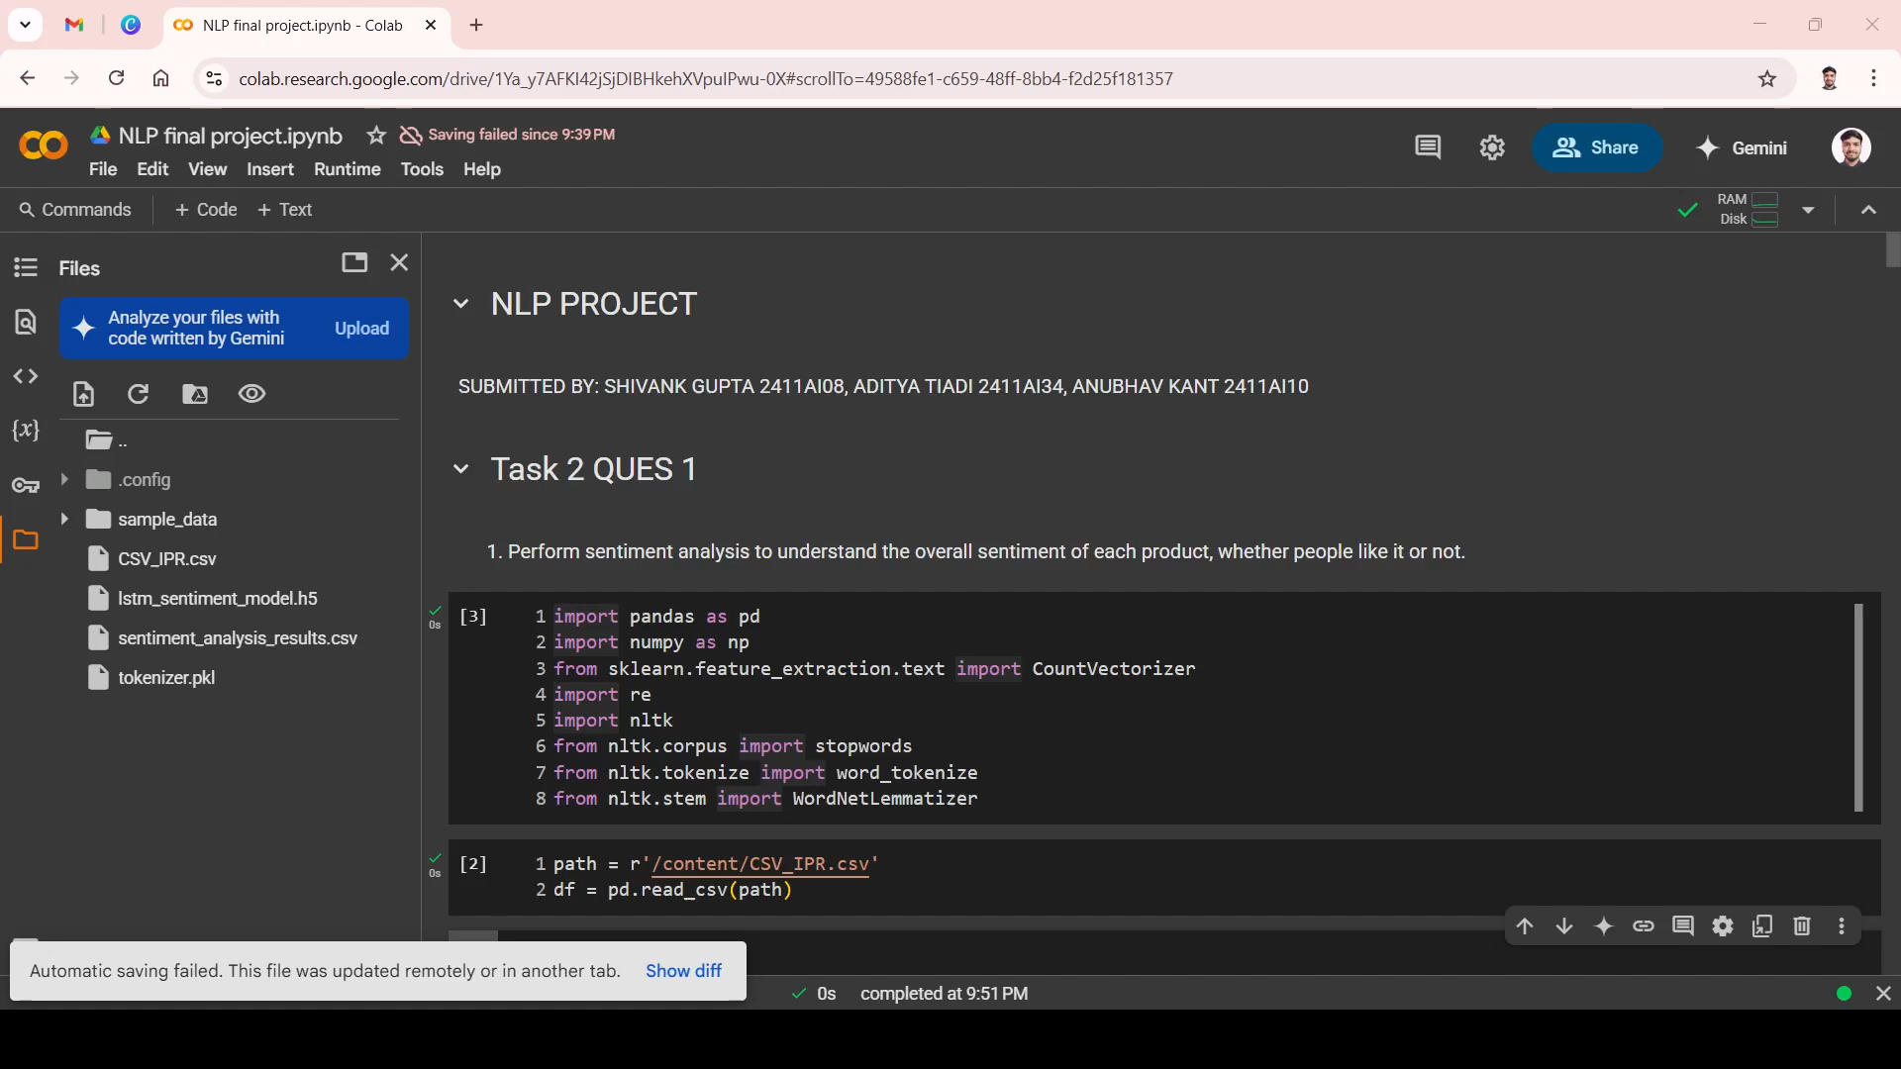

Slide 17
Thank You

